Slide 1
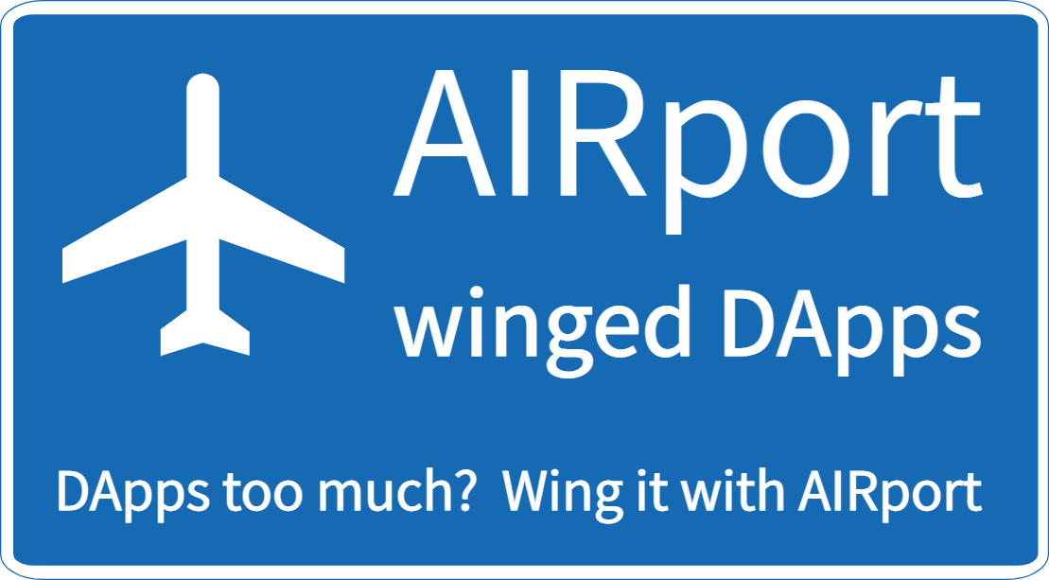
Developer friendly DApp development

Slide 2
History
Wrote Family Organizer app in 2015
Realized that a centralized server would be required and families would have to give up their data
Started writing AIRport (then QD-TS) in 2016 with a very small scope
It kept on growing and evolving until it reached multi-App phase
Got a patent this January – wife made me do it ☺
Starting full time development (5 month Filecoin dev grant), looking for additional sponsorship to grow quicker

Slide 3
Summary
Why?
How?
Users share data
Apps share data – cross App synergies
New apps access existing data.
Hybrid decentralized/centralized applications.
Virtual Repositories
Database on each end-user device
Automatic schema upgrades
Schema backward compatibility

Slide 4
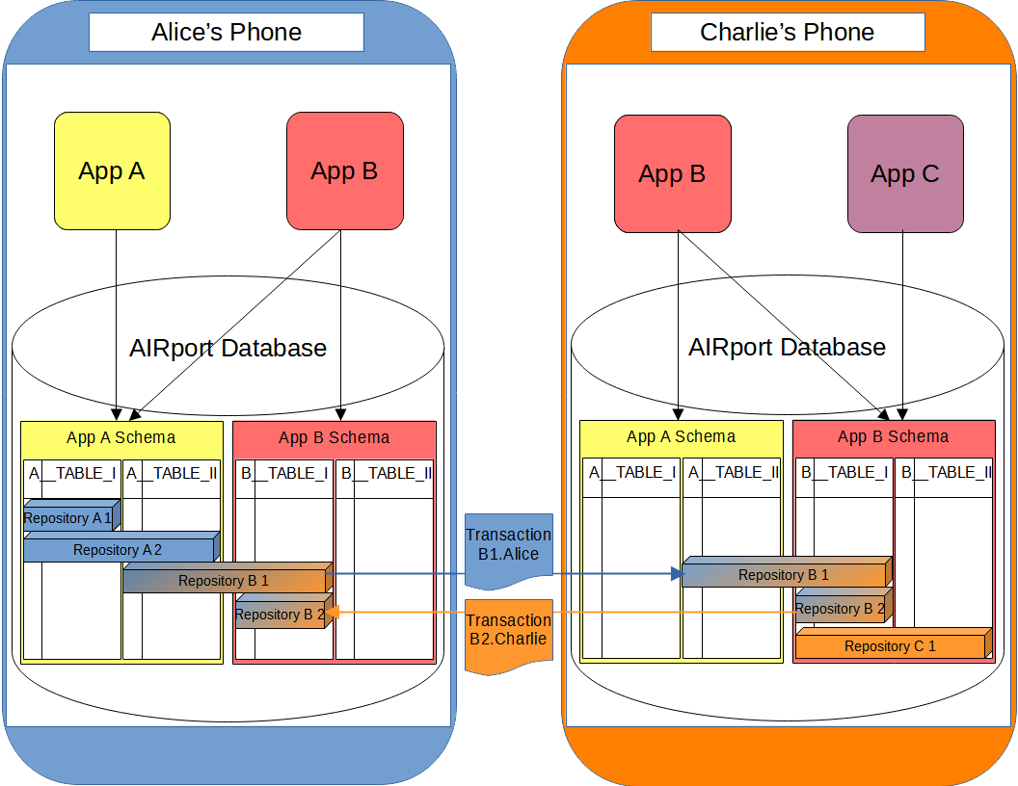

Slide 5
App collaboration & data reuse
User is in control of their data they allow applications to access their data (usually only a part of their data).
Apps are in control of sharing schemas with other applications
Apps can allow or deny access to their schemas.
Natural tendency towards specialized, add-on Apps – promoting indie development

Slide 6
Backend
Arweave is perfect because of tags and fast response times
IPFS will work with semi-centralized, multi-tier sharing servers
S3 will also work in the same way as IPFS (still a DAG)
For some applications centralized data storage may be a better option
Ultimately it can work in hybrid environments – decentralized personal data - centralized indexing servers for public/social apps, backed by decentralized data as well - once public data ages out of high throughput servers, it is still retrievable from Arweave

Slide 7
Economics - incentives
App Users – keep data private, remove per-App data duplication, profit sharing
App Creators – profits from apps, grow market share, focus on apps
AIRport – attract App developers to platform

Slide 8
Economics - Monetization
Decentralized Ads – they aren’t bad if data kept private – “advertisement is an engine of progress”
Profit sharing – all 3 parties get a cut of revenue
Fee model – opt of Ads on wholesale/per App/per repository

Slide 9
DeveloPER friendly
Well known relational database standard
Decorator/Annotation based ORM
“Better than Graph QL” – interlinked object graph retrieval
Declarative, nested validation rules
Shared schema and app logic code, running in V8 isolates
Observable data (eventually)

